Slide 1

C++ Fundamentals

Slide 2
Schedule - day 1
tbd

Slide 3
Another programming language …
It is assumed that:
You have basic knowledge in C, and know at least the operators.
You have the skills to write “HelloWorld.c”
Why should we learn another language?????
Newer language provides a larger toolbox.
Some code can be simpler and shorter using more advanced features.
…

Slide 4

C++ history

Slide 5
Why C++
Because C++ is designed to be :
a statically typed, general-purpose language that is as efficient and portable as C
directly and comprehensively support multiple programming styles (procedural programming, data abstraction, object-oriented programming, and generic programming)
give the programmer choice, even if this makes it possible for the programmer to choose incorrectly
as compatible with C as possible, therefore providing a smooth transition from C
function without a sophisticated programming environment
avoids features that are platform specific or not general purpose
does not incur overhead for features that are not used (the "zero-overhead principle")

Slide 6
History (1/2)
1979 – Bjarne Stroustrup began work on "C with Classes".
1983 - the name of the language was changed from C with Classes to C++
New features were added including virtual functions, function name and operator overloading, references, constants, user-controlled free-store memory control, improved type checking, and BCPL style single-line comments with two forward slashes (//).
1985 - the first edition of The C++ Programming Language was released, providing an important reference to the language, since there was not yet an official standard.
1989 - Release 2.0 of C++
New features included multiple inheritance, abstract classes, static member functions, const member functions, and protected members.
1990 - The Annotated C++ Reference Manual was published.
Late addition of features included templates, exceptions, namespaces, new casts, and a boolean type.

Slide 7
History (2/2)
1998 - the C++ standards committee published the first international standard for C++ ISO/IEC 14882:1998, which would be informally known as C++98
The Standard Template Library (STL), which began its conceptual development in 1979, was also included
2005 - the C++ standards committee released a technical report (dubbed TR1) detailing various features they were planning to add to the latest C++ standard. The new standard was informally dubbed C++0x as it was expected to be released sometime before the end of the first decade.
2011 - the new C++ standard (dubbed C++11) was finished. The Boost library project made a considerable impact on the new standard, and some of the new modules were derived directly from the corresponding Boost libraries. New features: regular expression support, a comprehensive randomization library, a new C++ time library, a standard threading library, a new for loop syntax (foreach), the auto keyword, new container classes, better support for unions and array-initialization lists, and variadic templates.
2014 – C++14 was released. It is a minor update of C++11. Next version planned to be C++17

Slide 8

C++ References

Slide 9
Where to find additional materials
http://en.cppreference.com/w/cpp/
http://www.learncpp.com/
https://isocpp.org/wiki/faq/
McConnell, Steve. Code Complete. Second edition, 2004

Slide 10
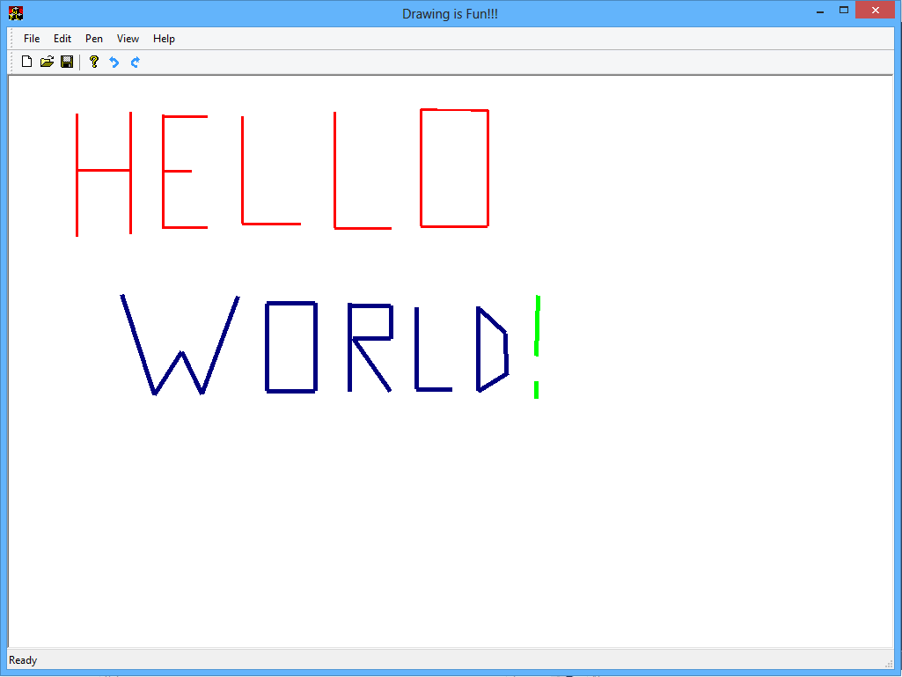
Structure of a C++ Program

Slide 11
“Hello World!”
hello.cpp
// A simple C++ program
#include <iostream>
int main()
{
std::cout << "Hello there!" << std::endl;
return 0;
}

Slide 12
Structure of a C/C++ Program - Absolute Minimum
// A simple C++ program
#include <iostream>
int main()
{
std::cout << "Hello there!" << std::endl;
return 0;
}

Slide 13
Structure of a C/C++ Program - Returning Value
// A simple C++ program
#include <iostream>
int main()
{
std::cout << "Hello there!" << std::endl;
return 0;
}

Slide 14
Structure of a C/C++ Program - Include headers
// A simple C++ program
#include <iostream>
int main()
{
std::cout << "Hello there!" << std::endl;
return 0;
}

Slide 15
Structure of a C/C++ Program - Comments
// A simple C++ program
#include <iostream>
int main()
{
std::cout << "Hello there!" << std::endl;
return 0;
}

Slide 16
Structure of a C/C++ Program – Actual work
// A simple C++ program
#include <iostream>
int main()
{
std::cout << "Hello there!" << std::endl;
return 0;
}

Slide 17

Language basics
Keywords
Literals, strings, identifiers and comments
Basic types

Slide 18
Declaration vs. Definition
Declaration – it tells the compiler the name and type of an object, function, class or template but miss some details about them. It doesn’t allocate memory for it:
extern int x; // object declaration
int numDigits( int number ); // function (forward) declaration
class Clock; // class (forward) declaration
// only the name but not the body
template<class T> // template (forward) declaration
class SmartPointer; // only the name but not the body
Definition – it gives the compiler the complete description.
object – this is the place where the compiler allocates memory for it.
method/function – it gives the its body (implementation)
class/template – it lists its members
int x; // object declaration
// memory is allocated
void SayHello() // function declaration
{
std::cout << "Hello :)" << std::endl;
}

Slide 19
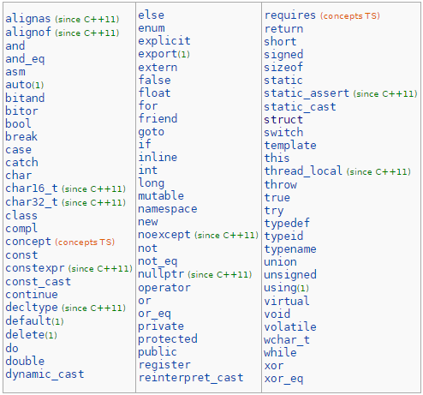
Keywords (1 / 4)
This is a list of reserved keywords in C++. Since they are used by the language, these keywords are not available for re-definition or overloading.

Slide 20
Keywords (2 / 4)
The reserved words of C++ may be conveniently placed into several groups. In the first group we put those that were also present in the C programming language and have been carried over into C++. There are 33 of these, and here they are:
asm
auto
break
case
char
const
continue
default
do
double
else
enum
extern
float
for
goto
if
int
long
register
return
short
signed
sizeof
static
struct
switch
typedef
union
unsigned
void
volatile
while

Slide 21
Keywords (3 / 4)
There are another 30 reserved words that were not in C, are therefore new to C++, and here they are:
dynamic_cast namespace reinterpret_cast try bool explicit export new static_cast typeid catch false operator template typename class friend private this using const_cast inline public throw virtual delete mutable protected true wchar_t

Slide 22
Keywords (4 / 4)
The following 11 C++ reserved words are not essential when the standard ASCII character set is being used, but they have been added to provide more readable alternatives for some of the C++ operators, and also to facilitate programming with character sets that lack characters needed by C++.
and
bitand
compl
not_eq
or_eq
xor_eq
and_eq
bitor
not
or
xor

Slide 23
Variables & Types - Introduction
Programs usually need to store different objects (numbers – length, age, etc; strings – names, sentences, etc.) and use them, possibly multiple times
Example: A program that takes an IBAN as input and calculates whether the IBAN is valid or not. It needs to store the original IBAN, perform intermediate operations on it and check the result
Those items (the IBAN, intermediate numbers/characters and the final result) need to be stored in different places of computer’s memory
A variable is associated with specific location (address) in memory, storing a certain type of data (i.e. a number, a string, etc.)
Example: on address 0x7fffe217349c, the value 32 is stored.
However the address is very unnatural for a human to work with: in programming languages names are used to work with that variable’s data; compiler remembers the corresponding address and uses it behind the scenes

Slide 24
Variables & Types - Memory (simplified)
What programmer uses (i.e. int age = 5;) is much more readable than the actual machine representation:
Content | 00 | 00 | 05 | 00 | 00 | 00 | 00
Address | 80002 | 80003 | 80004 | 80005 | 80006 | 80007 | 80008
How they correspond:
int is the variable’s type. It determines two things:
How much space variable age occupies – variable’s size (in this case 4 bytes)
How is the data in this space interpreted (everything inside computer’s memory is a number actually, even things like color, name characters, temperature, etc.)
age is the variable’s name. It is for programmer’s convenience and compiler maps it to a specific starting address (in this case 80003)
= 5 here is the initial value that the variable age receives

Slide 25
Variables & Types - Example
Extend the “Hello world” example to use a variable and print its value, address and size in bytes:
#include <iostream>
int main()
{
int age = 20;
std::cout << age << std::endl; // Value of age
std::cout << &age << std::endl; // Address of age
std::cout << sizeof(age) << std::endl; // Size of age
return 0;
}

Slide 26
Basic Types (1/6)
C++ offers several fundamental types which are basically used to specify:
What kind of data a variable / constant contains
What kind of data a function returns
On top of them, C++ allows to build user-defined, abstract data types (ADTs) which are subject of OOP course.
The following tables will also show typical sizes of different types in octets (8-bit bytes).
Those sizes are highly machine-dependant!
Do not assume this is always the case!
Rely on sizeof in your software to determine the size of a type and/or variable if you need it!

Slide 27
Basic Types (2/6)
C++ add new bool type to all defined in C. And wchar_t is keyword in C++ and typedef in C.
Name | Description | Size* | Range*
char | Character or small integer. | 1byte | signed: -128 to 127 unsigned: 0 to 255
short int (short) | Short Integer. | 2bytes | signed: -32768 to 32767 unsigned: 0 to 65535
int | Integer. | 4bytes | signed: -2147483648 to 2147483647 unsigned: 0 to 4294967295
long int (long) | Long integer. | 4bytes | signed: -2147483648 to 2147483647 unsigned: 0 to 4294967295
bool | Boolean value. It can take one of two values: true or false. | 1byte | true or false
float | Floating point number. | 4bytes | +/- 3.4e +/- 38 (~7 digits)
double | Double precision floating point number. | 8bytes | +/- 1.7e +/- 308 (~15 digits)
long double | Long double precision floating point number. | 8bytes | +/- 1.7e +/- 308 (~15 digits)
wchar_t | Wide character. | 2 or 4 bytes | 1 wide character

Slide 28
Basic Types (3/6)
void can mean 2 logically different things in C++, depending on context:
“Nothing”
“Any” / “Unknown” type
There is no void variable (variable of type void)!
In the above meanings, void either means “Nothing is passed to/from a certain function” (more on functions later) or “An address in memory where unknown type of data (with unknown size and unknown interpretation) is located” – or, in other words, just an address.
bool type is capable of holding one of the two values: true or false

Slide 29

Basic Types (4/6)
Type | Typical sizeof | Notes
float | 4 | IEEE 754 single precision
double | 8 | IEEE 754 double precision
long double | 12 or 16 | IEEE 754 extended precision Differences mainly due to alignment (real size 80 bits)

Slide 30
Basic Types (5/6)
typedef – syntactic facility for introducing symbolic names for data types. It simplifies complicated type declarations and improve readability.
typedef type new_name;
More needed in C
Used for convenience in C++
Does not create a new type; just a new name (alias) of existing type
/* GLOBAL DATA TYPES AND STRUCTURES */
typedef unsigned char boolean; /* for use with TRUE/FALSE */
typedef signed char sint8; /* -128 .. +127 */
typedef unsigned char uint8; /* 0 .. 255 */
typedef signed short sint16; /* -32768 .. +32767 */
typedef unsigned short uint16; /* 0 .. 65535 */
typedef signed long sint32; /* -2147483648 .. +2147483647 */
typedef unsigned long uint32; /* 0 .. 4294967295 */
typedef signed long long sint64; /* \brief 64-bit unsigned integer */
typedef unsigned long long uint64;
typedef unsigned long uint8_least; /* At least 8 bit */
typedef signed long sint8_least; /* At least 7 bit + 1 bit sign */
typedef unsigned long uint16_least; /* At least 16 bit */
typedef signed long sint16_least; /* At least 15 bit + 1 bit sign */
typedef unsigned long uint32_least; /* At least 32 bit */
typedef signed long sint32_least; /* At least 31 bit + 1 bit sign */
typedef float float32;
typedef double float64;

Slide 31
Basic Types (6/6)
Example:
typedef unsigned int litres;
typedef unsigned int kilograms;
void DisplayTankVolume( const litres vol )
{
std::cout << "The tank volume is " << vol << std::endl;
}
int main()
{
const kilograms carWeight = 1800;
DisplayTankVolume( carWeight );
return 0;
}
Function expects litres but it receives kilograms and the compiler doesn’t warn us!!!

Slide 32
Constants
To a first approximation, a constant is just a variable with a fixed value. The compiler won’t allow you to change its value after initialization:
const double PI = 3.1415926; // PI initialized – a MUST in C++
double radius = 1; // radius initialized
double length = 0; // length initialized
length = 2 * PI * radius; // length assigned - OK, not const
// PI = 4; // error: assignment of read-only variable 'PI'
So, main specifics of const compared to non-const variables:
A const must be initialized (C++).
In C this is highly recommended, but not enforced as an error.
A const cannot be assigned (compilation error)

Slide 33
Symbolic Constants
A symbolic constant is a more fuzzy term. It is any way you associate a name to a constant value
Best way to define a symbolic constant is the const approach from previous slides:
An obsolete way (not recommended!) is to use a preprocessor macro.
Both ways to define a symbolic constant have the same intent, but different properties. Use the const approach – prefer compiler than preprocessor!
const double PI = 3.1415926; // PI which is a constant variable, is also a symbolic constant
#define PI 3.1415926

Slide 34
const & volatile (cv) type qualifiers (1/4)
const – const-qualified type is used to declare a constant type.
Syntax
Arguments
Type : type of the constant name : identifier of the constant value : initial value with the type of the constant
const Type name = value; // Constant object
Type * const name = value; // Constant pointer
const int cNAMESIZE = 10;
const char cName[cNAMESIZE] = "VW";
int i = 20;
int * const pConst = &i;

Slide 35
const & volatile (cv) type qualifiers (2/4)
volatile – keyword is a qualifier that is applied to a variable when it is declared. It tells the compiler that the value of the variable may change at any time–without any action being taken by the code the compiler finds nearby.
int main()
{
int a = 3;
int b = (++a) + (++a);
std::cout << b << std::endl;
return 0;
}
int main()
{
volatile int a = 3;
int b = (++a) + (++a);
std::cout << b << std::endl;
return 0;
}
prints: 10
prints: 9
Result is compiler dependent

Slide 36
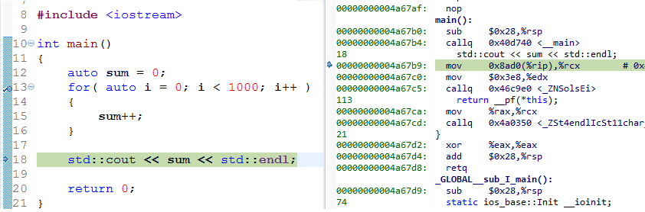
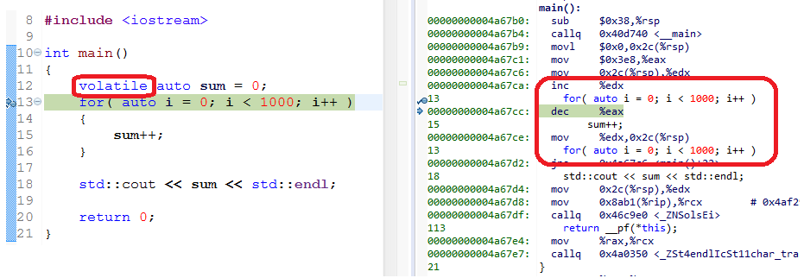
const & volatile (cv) type qualifiers (3/4)
Example compiled with g++ 5.1.0 with speed optimization – without volatile
Example compiled with g++ 5.1.0 with speed optimization – with volatile

Slide 37
const & volatile (cv) type qualifiers (4/4)
const volatile – Does it ever make sense to declare a variable in C or C++ as both volatile (i.e., “ever-changing”) and const (“read-only”)? If so, why? Give an example where cv is used!!
// Constant address to hardware register
volatile uint8 * const pRegister = reinterpret_cast<uint8 *>( 0x000F000 );
// Read-only hardware register
const volatile uint8 * const pReadOnlyReg = reinterpret_cast<uint8 *>( 0x000A000 );

Slide 38
Const object
Use const whenever it makes sense!
Usage:
Declaration of variables and parameters
Class functions
Pointers and etc.
Pros – helps people to understand how variables are being used. Allows the compiler to do better type checking, and, conceivably, generate better code. Helps people convince themselves of program correctness because they know the functions they call are limited in how they can modify your variables. Helps people know what functions are safe to use without locks in multi-threaded programs.
Cons – const is viral - if you pass a const variable to a function, that function must have const in its prototype (or the variable will need a const_cast). This can be a particular problem when calling library functions.

Slide 39
Const object and the context
The constness of the object depends on the context in which it is used:
struct Car
{
const char* brand;
const char* model;
double price;
double hp;
bool isConvertable;
bool isPetrol;
};
void DisplayCarName( const Car& theCar )
{
std::cout << "The car brand is "
<< theCar.brand
<< " and the model is "
<< theCar.model << std::endl;
}
Object is immutable in the
context of DisplayCarName function!
int main()
{
Car car;
car.brand = "VW";
car.model = "Golf";
DisplayCarName( car );
car.brand = "Audi";
car.model = "A4";
DisplayCarName( car );
}
Object is mutable in the
context of main function!

Slide 40
Literals (1/2)
Literals are also constants (in broad sense!) but they are just the constant values themselves, not the const variable to which they are assigned.
Back to the example:
Other examples of literals:
const double PI = 3.1415926; // PI - constant variable, 3.1415926 – literal
double radius = 1; // 1 is literal
double length = 0; // 0 is literal
length = 2 * PI * radius; // (2 * PI * radius) is an expression
// PI = 4; // 4 is literal
bool ready = true; // true is a boolean literal
const char *l = "str lit"; // str lit is a string literal
char c = 'Q'; // Q is a char literal

Slide 41
Literals (2/2)
Printable character
‘a’ ‘b’ ‘\\’ ‘;’
Character by its octal, decimal or hexadecimal code
'\010' '\178' '\x5e’
Escape sequences
‘\a’ alarm ‘\b’ Backspace ‘\f’ feed ‘\n’ end of line ‘\t’ horizontal tab ‘\v’ vertical tab ‘\0’ null
Numbers
12.24e10 .122E12 12.2F +12.2
123U 123LU 0123 0xfb

Slide 42
Comments
Line comment - start with ‘//’ and comments till the end of the line
// This is line comment
Block comment - start with ‘/*’ and comments till the end with ‘*/’. These comments might be spread in multiple lines.
/* this is block comment */

Slide 43
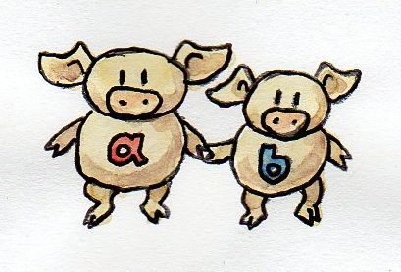
User-Defined Types
Enumerations, Structures, Unions

Slide 44
Plain Old Data Concept – POD Type
POD Type – is a concept in C++ which is used to classify a type of an object which is compatible with the types used in the C programming language. This type can be manipulated (created, moved, etc) using C library functions. Such types could be:
Scalar Type – every primitive type (int , short , char , enum , etc.) which is inherited from C programming language.
Class Type( class, struct, union ) – every composite type which is inherited from C programming language (except class) and has a trivial constructor.
TODO: mention that C++ imposes overhead over C memory model only for non-POD types (i.e. when necessary)
In this chapter we will consider only POD types!

Slide 45
Enumerations – Basics
If you need a type with several distinct values, but prefer your values to have names instead of just numbers, i.e.:
today = WEDNESDAY;
instead of
today = 2; // Umm… are we counting from 0 or 1?
Q: Why not just use string? (Hint: find at least 3 reasons)
Syntax:
How to define an enum type
enum enum_name {list_of_enumerators} var_list;
var_list is optional, rarely used
enum color_t
{
BLACK,
RED,
GREEN,
BLUE
};
How to use an enum type
enum color_t color1 = RED; // C – requires "enum" to define a variable
color_t color2 = BLUE; // C++ - you may omit "enum" here

Slide 46
Enumerations – Memory
Behind the scenes, enum is (typically) just an int
today = WEDNESDAY; // C/C++ source code
Typical memory content of today:
value | 2 | 0 | 0 | 0
offset | 0 | 1 | 2 | 3
Practice 1: “View memory” an enum variable assignment
Practice 2: sizeof several enum types / variables

Slide 47
Enumerations – C vs C++
C and C++ differ in a few aspects related to enum
C++: Each enum is a separate type.
C enums are little more than “syntax sugar” over int
Exercise: Check the above claims using assignment (a=b)
Both C and C++ export their enumerators (the possible values of an enum) in the namespace that contains the enum:
C requires a little heavier syntax
enum color_t
{
BLACK,
RED,
GREEN,
BLUE
};
enum flag_t
{
RED, // error - redefinition of "RED"
GREEN // error - redefinition of "GREEN"
};

Slide 48
Structures – Basics
Purpose: to group several logically related variables (possibly of different types!) into one variable/object of a new, user-defined type
Example:
We’d like to name this group (i.e. Person) and use it as a whole, making our own new type just as int, bool, etc.
Define variables of the new type, pass data around, let compiler do type checks, etc.
std::string name;
int birthYear;
int height;
bool hasDrivingLicense;

Slide 49
Structures – Syntax
struct type_name {type1 member1; type2 member2; …} var_list;
Example
struct Person
{
std::string name;
int birthYear;
int height;
bool hasDrivingLicense;
};

Slide 50
Structures – memory representation
We have a ADT called Car with several members:
struct Car
{
const char* brand;
const char* model;
double price;
double hp;
bool isConvertable;
bool isPetrol;
};
std::cout << sizeof( char* ) << std::endl; // prints: 8
std::cout << sizeof( double ) << std::endl; // prints: 8
std::cout << sizeof( bool ) << std::endl; // prints: 1
std::cout << sizeof( car ) << std::endl;
What is the size of Car?!?!

Slide 51
Structures – memory representation
Car object memory layout
Address
Space
0x1000
char*
brand
0x1008
char*
model
0x1010
double
price
struct Car
{
const char* brand;
const char* model;
double price;
double hp;
bool isConvertable;
bool isPetrol;
};
0x1018
double
hp
0x1020
bool
bool
padding
isPetrol
isConvertable
Size is 40 bytes due to memory alignment!

Slide 52
Structures – Memory
Members are situated in memory in their order of declaration…
However there are some subtleties…
Practice1 - Define a structure containing a char, int and double. Print the size of the new type to the console. Print the sum of sizes of the fields (member variables). Observe the difference!
Practice2 – Define a structure containing 3 char members and one int. Check its sizeof. Then rearrange the order of its members (i.e. char - char - int – char). Observe how its sizeof changes again!

Slide 53
Structures – Initialization
Structures can be initialized using brace-enclosed initializer:
struct Person
{
std::string name;
int age;
};
Person p1 = {"Toni", 21};

Slide 54
Structures – C vs C++
In C++ struct is pretty much like a class
… with a few minor differences
In C, a struct is just that: grouping of fields (variables) of (possibly different) types, to make a new, user-defined type.

Slide 55
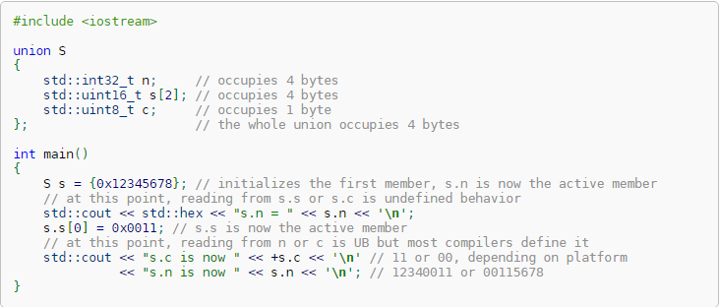
Union type
Union type – is a structure whose elements are all starting from the same memory address (located in the same memory area).
The union is only as big as necessary to hold its largest data member. The other data members are allocated in the same bytes as part of that largest member. The details of that allocation are implementation-defined, and it's undefined behavior to read from the member of the union that wasn't most recently written.

Slide 56
Operations on structures and unions (1/2)
Declaration of a structure
Selection of a member “.”
Assignment “=”
The default behavior for the assignment is a copy member to member operation.
MSGSpeedData speed; // Declaration of a variable structure
MSGOilData oil = { MSG_OIL_UPDATE, 10 }; // Declaration with initialization
oil.level = 25;
oilAvgValue = oil;

Slide 57
Operations on structures and unions (2/2)
Anonymous struct or union
A declaration of a union is initialized with the initialization of the first element.
struct Protocol
{
int version;
union
{
MSGSpeedData speed;
MSGOilData oil;
MSGDimmingData dimming;
};
};
Protocol aPacket;
aPacket.version = 0x101;
aPacket.oil.oilLevel = 5;

Slide 58

Storage Duration & Linkage

Slide 59
Storage duration
Storage duration – Every object has a property called storage duration, which limits the object lifetime
Automatic (“in the stack”) storage duration.
The object is allocated at the beginning of the enclosing code block and deallocated at the end. All local objects have this storage duration, except those declared static, extern or thread_local
Static (global / namespace variables and static variables) storage duration.
The storage for the object is allocated when the program begins and deallocated when the program ends. Only one instance of the object exists. All objects declared at namespace scope (including global namespace) have this storage duration, plus those declared with static or extern .
int main()
{
int count = 0; // Memory (storage) is allocated for variable count
// count is being used, its storage is available...
} // The storage of count is automatically deallocated

Slide 60
Storage duration
Dynamic (“in the heap”) storage duration.
The object is allocated and deallocated per request by using dynamic memory allocation functions.
Thread storage duration.
The object is allocated when the thread begins and deallocated when the thread ends. Each thread has its own instance of the object. Only objects declared thread_local have this storage duration. thread_local can appear together with static or extern to adjust linkage (C++11 and above)

Slide 61
Linkage
Linkage – is applied to names of object, reference, function, type, template, namespace, or value. It represents the ability of the name to be referred in other scopes. If a name has linkage, it refers to the same entity as the same name introduced by a declaration in another scope. If a variable, function, or another entity with the same name is declared in several scopes, but does not have sufficient linkage, then several instances of the entity are generated. The following linkages are recognized:
No linkage – The identifier can be referred to only from the scope it is in. All function parameters and all non-extern block-scope variables (including the ones declared static) have this linkage.
Internal linkage - The identifier can be referred to from all scopes in the current translation unit. All static identifiers (both functions and variables) have this linkage.
External linkage - The identifier can be referred to from any other translation units in the entire program. All non-static functions, all extern variables (unless earlier declared static), and all file-scope non-static variables have this linkage.

Slide 62
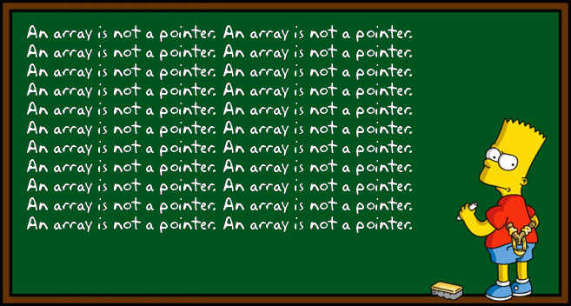
Pointers, arrays, references

Slide 63
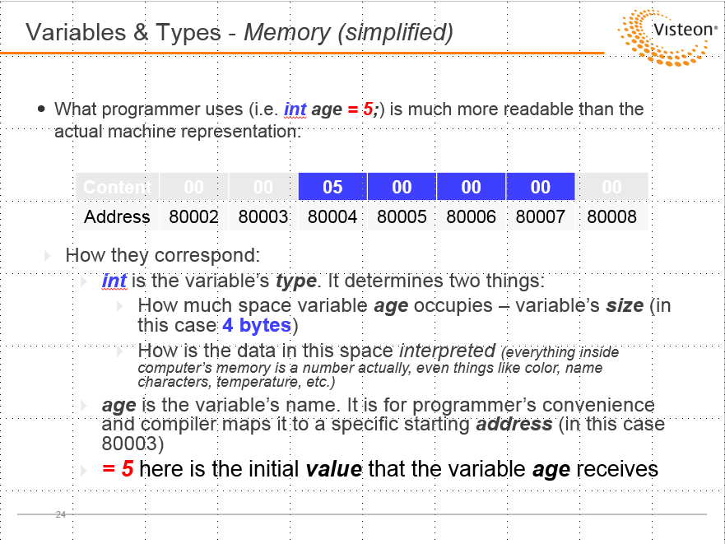
Pointers - Introduction
Remember that “memory model” diagram?
Usually, variables store data we are interested in – a number (age, temperature), a string (name), etc.
Special variables store adresses (i.e. of other variables) – such as 80004 from the above example. Such variables are called Pointers. Their purpose in life is to store location of other variables (which is also a useful data, so they are variables by nature).

Slide 64
Pointers in Memory
Content | f4 | 07 | 00 | 00 | 00 | 00 | 00 | 00 | 05 | 00 | 00 | 00 | …
Address | 7ec | 7ed | 7ee | 7ef | 7f0 | 7f1 | 7f2 | 7f3 | 7f4 | 7f5 | 7f6 | 7f7 | …
Step 1 – Start with a variable: int age = 5;
Note that usually the programmer doesn’t decide where a variable will be located (its starting address): it is automatically assigned by “the system” (compiler, linker, runtime environment / operating system working together)
In this specific case, the variable was created on address 0x7f4 (which is 2036 in decimal), because it was known to be free at that time
Check the real address using: std::cout << &age;
Step 2 – Let’s make a pointer – it’s just another variable meant to store addresses!
int* ptrAge = &age;
So, we have taken the address of age (&age) and assigned it to a new variable named ptrAge. The type of the new variable is int* which means it does not contain integer, but the (starting) address / location of an integer
The new variable ptrAge is an int pointer (pointer of type int*, pointer-to-int) that currently contains the address of the variable age

Slide 65
Why pointers?
To be able to not only print addresses but also store them and use them later
C/C++ offer also pointers to functions. This allows for powerful techniques for solving complex problems efficiently even with C (no OOP)

Slide 66
Pointer type
Syntax
Arguments
Type type of object namePointer pointed identifier of pointer &Object address of proper object type
Properties
A pointer type is automatically set for any new type created. A pointer access an object indirection. The multiple indirections can be (pointer to pointer).
In C++ Pointers are typed
Beware of uninitialized pointers or pointing to an unallocated object.
Type* namePointer;
Type* namePointer = &Object;

Slide 67
void* Pointer
The type "void *" is used to declare a pointer designating an untyped address.
struct Person
{
const char * name;
int age;
};
struct Car
{
int age;
Person * driver;
Person * owner;
};
void *ptr;
Person me = { "GRT", 35 };
Car myCar = { 5, &me, &me };
// The assignment works in the direction right to left
// (void * = Type *)
ptr = &me;
ptr = &myCar;
Car * pToCar = ptr; // OK in ANSI C, NOK in C++
pToCar = (Car *)ptr; // OK in C++
A "void *" cannot be dereferenced!

Slide 68
Function pointer
It is possible to take the address of a function and store it in a function pointer. The pointer can then be used to indirectly call the function:
double multiply( const double x, const double y )
{
return x * y;
}
double sum( const double x, const double y )
{
return x * y;
}
int main()
{
double (*pMath)( const double, const double );
pMath = &multiply; // assign address to multiply
std::cout << pMath( 10, 12 ) << std::endl; // prints 120
pMath = &sum; // assign address to add
std::cout << pMath( 10, 12 ) << std::endl; // prints 22
return 0;
}

Slide 69
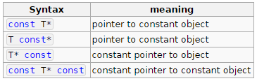
const & volatile in pointers
Usage
If cv appears before * in the pointer declaration, it is part of decl-specifier-seq and applies to the the pointed-to object.
If cv appears after * in the pointer declaration, it is part of declarator and applies to the pointer that's being declared.

Slide 70
Constant pointer to constant (1/2)
Syntax
Arguments
Type: type of the object pointed pNAME: identifier pointer constant &Object: address of the object pointed
Type Object;
Type * const pName = &Object;
const Type Object2;
const Type * const pName2 = &Object2;

Slide 71
Constant pointer to constant (2/2)
Examples
int int1;
int * pToInt;
int * const pConstToInt = &int1; // Allowed
* pConstToInt= 10; // Allowed
pConstToInt= &int1; // Prohibited
const int * const pConstToConstInt;
// Error - Not initialized!
pConstToConstInt = &int1; // Prohibited
pToInt = pConstToConstInt; // Prohibited
const int * pToConstInt = &int1; // Allowed
pToConstInt = pConstToConstInt; // Allowed

Slide 72
Arrays - Introduction
We’d like to group multiple objects of the same type and on contiguous memory addresses and work with all of them as a whole
Example
Arrays can be initialized using the following syntax:
Array’s name is the starting address. Try this:
int arr[10];
int arr[10] = {1, 2, 3, 8, 1}; // The rest is filled with 0
int arr[10];
std::cout << arr << std::endl;
std::cout << &arr << std::endl;
Array – set of objects [elements] all are of the same type and are arranged continuously in memory. Each element is identified by an index and has dimension. The dimension is fixed and must be known during compile time.

Slide 73
Arrays – Pointer arithmetic
int main()
{
int numbers[] = {1, 2, 3, 18}; // Initialize - compiler counts the size
int* inspector = &numbers[1]; // Direct inspection of the second element
std::cout << *inspector << std::endl; // Prints 2
/**
* Pointer arithmetics
* Unlike int variables, inspector is incremented by multiplies of sizeof(int)
* because pointer type is int*
*/
inspector = inspector + 1; // Redirects to the next element
std::cout << *inspector << std::endl; // Prints 3
inspector++;
std::cout << *inspector << std::endl; // Prints 18
inspector--;
std::cout << *inspector << std::endl; // Prints 3 again
return 0;
}

Slide 74
Arrays – C strings (intro)
In C, there is no separate “string” type. Instead, char arrays, char* pointers and C-string literals are used:
C-string – is a consecutive sequence (i.e., array) of characters which are terminated by a null character.
String variable - is defined to be of type char*. A pointer is simply the address of a memory location.
Notes:
"My Name" and "Your Name“ are string literals and have static storage duration. They may reside in read-only memory segment (platform-depedent!)
name – an array of 10 char elements. Uninitialized!
name1 – an array of 8 char elements. Size – automatically determined by the compiler: (7 + 1) including end-of-string marker (with value 0).
name2 variable is just a pointer to const char initialized to point to the starting address of "Your Name“ storage. Unlike arrays, name2 is not associated with information about number of elements (it’s not an array!)
char name[10];
char name1 = "My Name";
const char* name2 = "Your name";

Slide 75
Arrays – C strings (how to use)
int main()
{
char name[10]; // name is of type char[10]
char name1 = "My Name"; // name is of type char[8]
const char* name2 = "Your name"; // name is of type const char*
std::cout << name << std::endl; // Explosive! Also prints garbage
std::cout << name1 << std::endl; // OK. Prints "My Name"
std::cout << name2 << std::endl; // OK. Prints "Your Name"
std::cout << sizeof(name) << std::endl; // 10
std::cout << sizeof(name1) << std::endl; // 8
std::cout << sizeof(name2) << std::endl; // 4 (size of pointer)
return 0;
}

Slide 76
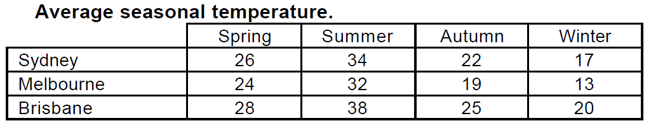
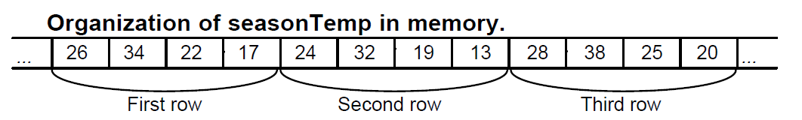
Arrays – multidimensional arrays
The organization of the array in memory is still the same (a contiguous sequence of elements), but the programmer’s perceived organization of the elements is different
int seasonTemp[3][4] =
{
{26, 34, 22, 17},
{24, 32, 19, 13},
{28, 38, 25, 20}
};

Slide 77
Pointers vs Arrays
Differences between array name vs. const pointer
Decay – loose information of length. Example with sizeof()
Recommendation: in C++ array usage is preferably replaced by std::vector<> or similar. Except for for low-level data structures, but even then encapsulated and protected against overruns etc.

Slide 78
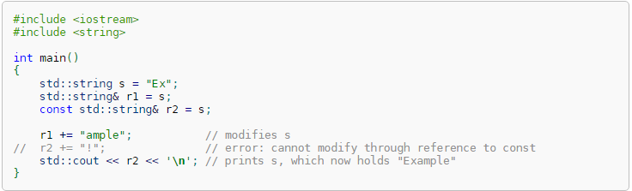
References
Declares a named variable as a reference, that is, an alias to an already-existing object or function.
A reference is required to be initialized to refer to a valid object or function. There are no references to void and no references to references.
References are not objects; they do not necessarily occupy storage, although the compiler may allocate storage if it is necessary to implement the desired semantics (e.g. a non-static data member of reference type usually increases the size of the class by the amount necessary to store a memory address).

Slide 79

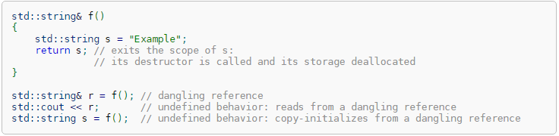
References
Because references are not objects, there are no arrays of references, no pointers to references, and no references to references:
Dangling references - Although references are supposed to be initialized to valid objects or functions, it is possible to create a program where the lifetime of the referred-to object ends, but the reference remains accessible (dangling). Accessing such a reference is undefined behavior. A common example is a function returning a reference to an automatic variable:

Slide 80

Expressions

Slide 81
Operators - Introduction
Variables help a program store data usually in order to manipulate it later.
C++ has a set of built-in operators that are used to manipulate variables (in other words – perform certain operations on them)
Examples
Operations add, subtract, etc. are performed using arithmetic operators (+, -, *, /, …)
Operations necessary to compare variables are performed using comparison (relational) operators (==, !=, <, >, …)
Other operator types – logical, assignment, bitwise, etc.

Slide 82
Operators - Precedence & Associativity
How will the following expression be evaluated?
2 + 3 * 4
Precedence – multiplication over addition (2 add to the result of 3*4)
Not happy? Use parentheses to change grouping to the way you need
(2 + 3) * 4
The result of 2 + 3 is multiplied by 4
Math already defines those, C++ sticks to the “natural” precedence
Apart from arhithmetic operators, many others exist in C++ so all those need a unified Precedence table…
How are sequential operators with the same precedence processed?
Associativity! Left-to-right / right-to-left

Slide 83
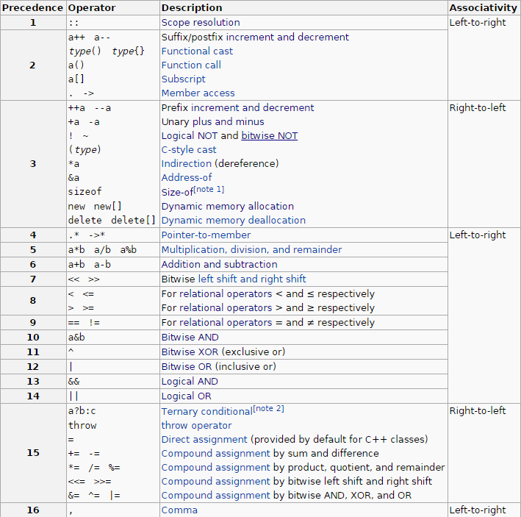
Operator Precedence

Slide 84
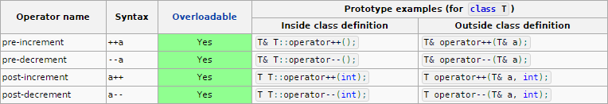
Increment/Decrement Operators
The increment (++) and decrement (--) operators provide a convenient way of, respectively, adding and subtracting 1 from a numeric variable.
Example:
// prefix increment ==>
// increment and fetch
Point& operator++( Point& l )
{
l._x++;
l._y++;
return l;
}
// sufix increment ==> fetch and increment
Point operator++( Point& l, int dummy )
{
Point oldVal;
oldVal._x = l._x;
oldVal._y = l._y;
++l; // Prefix used!
// Avoid recursion
return oldVal;
}

Slide 85

The sizeof Operator
Calculating the size of any data item or type. It takes a single operand which may be a type name (e.g., int) or an expression (e.g., 100) and returns the size of the specified entity in bytes. The outcome is totally machine-dependent.
void PrintStringSize( const char* str )
{
std::cout << "str contains " << sizeof( str ) << " bytes." << std::endl;
}
int main()
{
char whatIsMySize;
std::cout << "whatIsMySize contains " << sizeof( whatIsMySize ) << " bytes." << std::endl;
char greetings[] = "Hey wake up!";
std::cout << "greetings contains " << sizeof( whatIsMySize ) << " bytes." << std::endl;
PrintStringSize( greetings );
return 0;
}
Output:

Slide 86
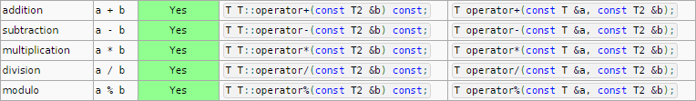
Arithmetic Operators
All arithmetic operators compute the result of specific arithmetic operation and returns its result. The arguments are not modified.
Example:
struct Point
{
double _x;
double _y;
};
Point operator+( const Point& l, const Point& r )
{
Point newPoint;
newPoint._x = l._x + r._x;
newPoint._y = l._y + r._y;
return newPoint;
}

Slide 87
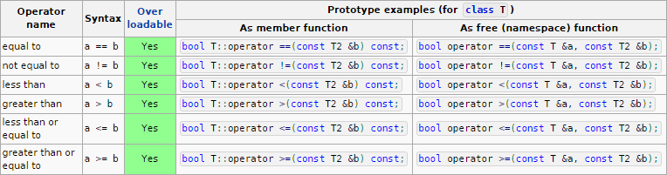
Relational Operators
C++ provides six relational operators for comparing numeric quantities. Relational operators evaluate to 1 (representing the true outcome) or 0 (representing the false outcome).

Slide 88
Relational Operators - Example
Recommendation: implement part of operators on top of the other operators
i.e. first implement == and then != on top of it
Consistency, maintainability etc.
Example:
struct Point
{
double _x;
double _y;
};
bool operator==( const Point& l, const Point& r )
{
const double delta = 0.0001;
double xDelta = l._x - r._x;
double yDelta = l._y - r._y;
if ( xDelta < 0 )
{
xDelta = -xDelta;
}
if ( yDelta < 0 )
{
yDelta = -yDelta;
}
return ( xDelta <= delta ) && ( yDelta <= delta );
}

Slide 89
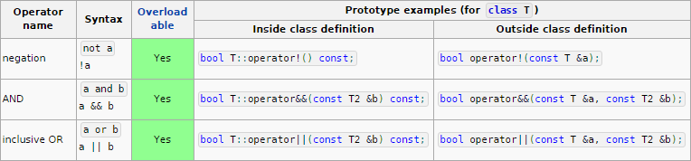
Logical Operators
C++ provides three logical operators for combining logical expression. Like the relational operators, logical operators evaluate to 1 or 0.
Example:
struct NaturalNumber
{
unsigned int num;
bool isPrime;
};
bool operator&&( const NaturalNumber& l, const NaturalNumber& r )
{
return l.isPrime && r.isPrime;
}

Slide 90
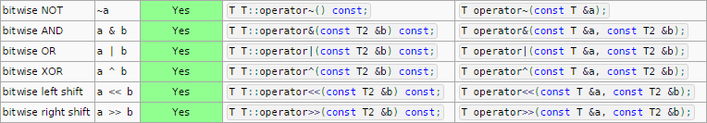
Bitwise Operators
C++ provides six bitwise operators for manipulating the individual bits in an integer quantity.
Example:
struct NaturalNumber
{
unsigned int num;
bool isPrime;
};
NaturalNumber operator~( const NaturalNumber& r )
{
NaturalNumber newNum;
newNum.isPrime = r.isPrime;
newNum.num = ~r.num;
return newNum;
}

Slide 91
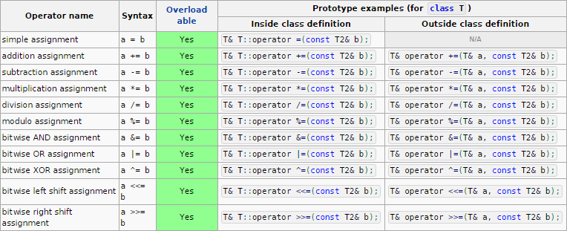
Assignment Operator
The assignment operator is used for storing a value at some memory location (typically denoted by a variable). Its left operand should be an lvalue, and its right operand may be an arbitrary expression. The latter is evaluated and the outcome is stored in the location denoted by the lvalue.

Slide 92
Assignment Operator – Example
Example
a += b
This is equal to: a = a + b
Point& operator+=( Point& l, const Point& r )
{
l._x += r._x;
l._y += r._y;
return l;
}
a = b: This is ONLY a member function!
Point& Point::operator=( const Point& r )
{
_x = r._x;
_y = r._y;
return *this;
}
Point p1 = { ._x = 1, ._y = 1 };
Point p2 = { ._x = 2, ._y = 2 };
Point p3 = { ._x = 0, ._y = 0 };
p1.operator =( p2.operator =(p3) );
p2 = p3 = p1;
In C this assignment returns r-value and so we can do this:
p1 = p2 = p3
In C++ returning by value will invoke unnecessary copies that is why it returns by reference.

Slide 93
Conditional Operator, Comma Operator
The conditional operator takes three operands. It has the general form:
operand1 ? operand2 : operand3
Comma operator is used to combine several expressions into one
success = ( temperature < ( 85 + 30 ) ) ? true : false;

Slide 94
Stream extraction and insertion
The overloads of operator>> and operator<< that take a std::istream& or std::ostream& as the left hand argument are known as insertion and extraction operators. Since they take the user-defined type as the right argument (their left argument is a stream), they must be implemented as non-members:
struct Point
{
double _x;
double _y;
};
std::ostream& operator<<( std::ostream& os, const Point& r )
{
return os << "x = " << r._x << " y = " << r._y;
}
std::istream& operator>>( std::istream& is, Point& r )
{
return is >> r._x >> r._y;
}
Usage:
Point p1 = { ._x = 1, ._y = 1 };
std::cout << "Enter x and y." << std::endl;
std::cin >> p1;
std::cout << p1 << std::endl;

Slide 95
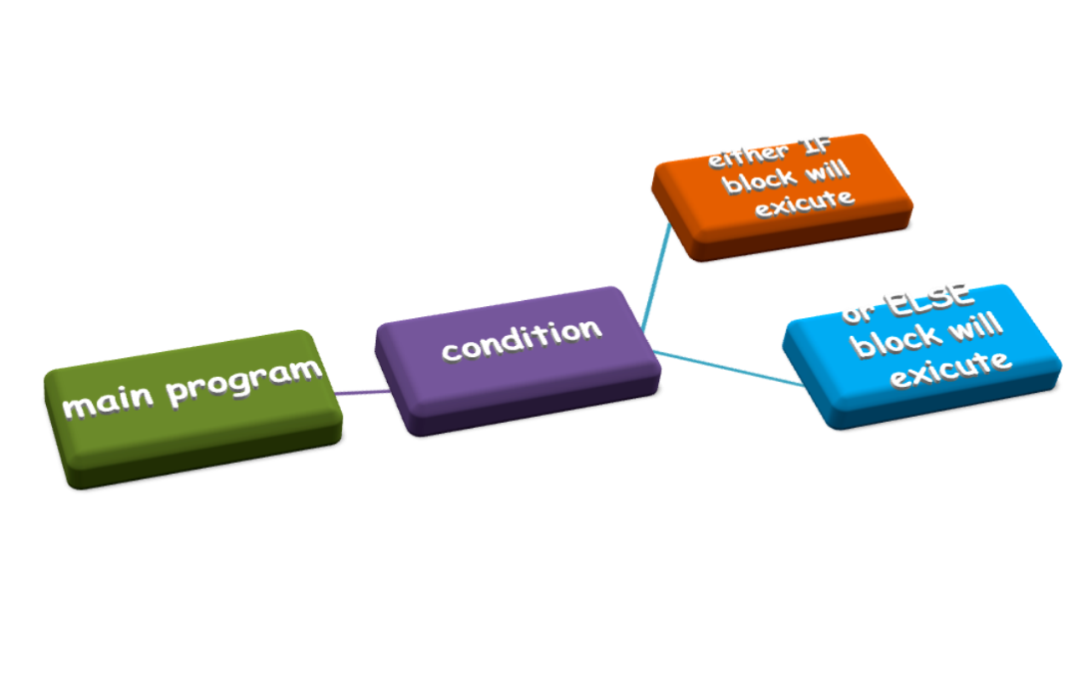
Statements

Slide 96
Simple statement
Simple statement – simply the “sentences” in the programming language
Variable definitions
Semicolon-terminated expressions
char whatIsMySize; // Declaration statement
char greetings[] = "Hey wake up!"; // Declaration statement
; // Null statement

Slide 97
Block (compound) statements
A sequence of statements surrounded by {…}
Examples
{x = 5; y++; z = x * y;}

Slide 98
Selection (conditional) statements
If-else
Switch-case
Ternary operator ?:
if (maxNumber < currentNumber)
maxNumber = currentNumber; // May be a block statement {…}
else // Optional…
misses++; // May be a block statement {…}

Slide 99
Iteration statements (loops)
While (pre-condition loop)
while (condition) statement // May also be a block {…}
Do-while (post-condition loop)
do statement while (condition); // May also be a block {…}
For
for ([decl-or-expr]; [decl-or-expr]; [expr]) statement
All of them iterate (execute statement repeatedly) while their condition is true
Main difference – when condition value is checked – before or after statement

Slide 100
Jump statements
break
Jump out of (terminate) for, while, do-while, switch
Does not terminate if / else
Does not jump out across multiple nested loops/switches
continue
Skips the rest of loop statements for current iteration
return
goto
Use only as a substitution of ‘labelled break’.
Apply very carefully!

Slide 101

Functions

Slide 102
User-defined function – Introduction
Function – is a named sequence of statements packaged in a convenient way which can be re-used as often as required (re-useable unit of code).
Name
Input Parameter
Return Type
bool IsEven( const unsigned int num )
{
bool result = false;
if ( !(num % 2) )
{
result = true;
}
return result;
}
Function Definition
Body
Return Value

Slide 103
User-defined function – Function Interface
Name
Input Parameter
Return Type
Function Interface
Name – it must be an unique identifier.
Actually there are a “kind of functions” without name – lambda functions
Use __PRETTY_FUNCTION__ if you need to get function name run time.
Return Type – this is the result which function returns, its output.
Result is return by value – single value copied over the stack!
The function could return no value – void which means “nothing”.
Input Parameters – this is the input which function uses for its calculations.
Input parameters are optional – function could take no parameters at all!
Input parameters are copied by value – over the stack too! And by reference!
Syntax for parameters is similar to syntax for defining variables.

Slide 104
User-defined function – Function Declaration
Function Declaration
Declaration vs Definition – do you remember that slide ☺
Function Declaration – simply consist of the function prototype followed by ;
Why do we need this? – if we need to use the function on a place in the code where it is not visible.
Parameter names – are optional but highly encouraged to be used!
Value Parameter (pass-by-value) – as was mentioned the function receives a copy of the value
Reference Parameter (pass-by-reference) – the function works directly with a “reference” of the value and any modification of the value modifies the real instance of the argument.

Slide 105
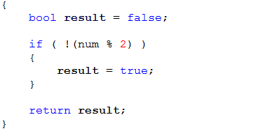
User-defined function – Function Body
Beginning
Local variable definition and initialization
Function Body
Business logic
Return value
End
Function body – contains computational steps (statements) that comprise the function
It always starts and ends with open “{“ and close “}” brackets.
In the body could have any valid set of statement(s), even could be empty.
In case of void return type – the return key word is optional.

Slide 106
User-defined function – Local and Global Scope
Remember the slide – “Storage Duration and Linkage” ☺

Slide 107
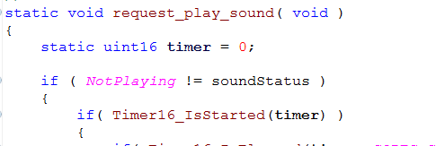
User-defined function – Static Variables and Functions
Internal Linkage
Internal Linkage
Internal Linkage
Remember the slide – “Storage Duration and Linkage” ☺ again.
static keyword applied before variable definition has the meaning of a global variable which is visible only in the scope of its definition.
Applied for global and local variables.
Both are automatically initialized to zero if there is no explicit initialization.
static keyword applied before function definition reduces the visibility of the function only in the scope of its definition.
By default (if no key word is applied) all functions are with external linkage.

Slide 108
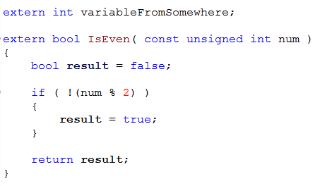
User-defined function – Extern Variables and Functions
External Linkage
External Linkage
External Linkage
Remember the slide – “Storage Duration and Linkage” ☺ again.
extern – is optional for functions! By default all functions are with external linkage except another is specified!
extern – is mandatory for variables which are used in another scope different from the scope of their definition (otherwise the linker will complain). This is the only way to declare a global variable without defining it!

Slide 109
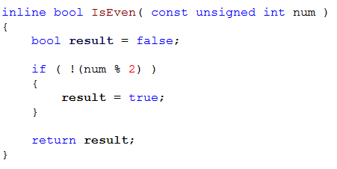
User-defined function – Inline Functions
the key word
inline – advice (not obligate) the compiler to “inline” (to copy-paste) the function on every place in the code where it has been used.
Looks like a macro ☺ - but it is not because the preprocessor doesn’t understand it, only the compiler does!
Yes you have type checking!

Slide 110
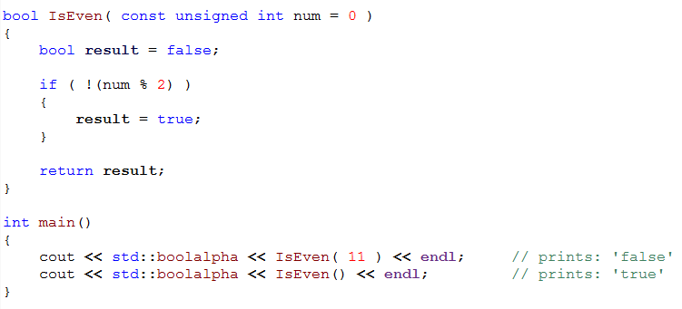
User-defined function – Default Arguments
Default argument
The same function
The same function
Default Argument – function “overloading” alternative. If the function is called without a parameter it will assume that it has been called with the default argument (“0” in this case)!

Slide 111

www.visteon.com

